Slide 1
Maintenance Therapies for Hodgkin and Non-Hodgkin Lymphomas After Autologous Transplantation A Consensus Project of ASBMT, CIBMTR, and the Lymphoma Working Party of EBMT
Dr. Saba Ghaffary
Assistant Professor of Clinical Pharmacy
Tabriz University of Medical Sciences

Slide 2
Disease relapse remains the most common cause of death in patients with lymphoma after undergoing HDT.
Most relapse events occur within the first 1 to 3 years following auto-HCT, providing a rationale for post-HCT maintenance and/or consolidative strategies to mitigate relapse risk.

Slide 3
MeSH Search:
“Non-Hodgkin lymphoma/therapy” = 21027 references
MeSH Search:
“Non-Hodgkin lymphoma/therapy” = 21027 references
MeSH Search:
“Non-Hodgkin lymphoma/therapy” = 21027 references
MeSH Search:
“Non-Hodgkin lymphoma/therapy” = 21027 references
MeSH Search:
“Non-Hodgkin lymphoma/therapy” = 21027 references
“Mantle cell lymphoma” = 1444 references
“Diffuse large B-cell lymphoma” = 3576 references
“Mantle cell lymphoma” = 1444 references
“Diffuse large B-cell lymphoma” = 3576 references
“Mantle cell lymphoma” = 1444 references
“Diffuse large B-cell lymphoma” = 3576 references
“Follicular lymphoma” = 2449 references
“Follicular lymphoma” = 2449 references
“Follicular lymphoma” = 2449 references
“Adult T-cell lymphoma” = 132 references
“Adult T-cell lymphoma” = 132 references
“Adult T-cell lymphoma” = 132 references
AND “transplantation, autologous” = 203 references
AND “chemotherapy, maintenance” OR “chemotherapy, consolidation” = 4 references
AND “transplantation, autologous” = 22 references
AND “chemotherapy, maintenance” OR “chemotherapy, consolidation” = 0 references
AND “transplantation, autologous” = 203 references
AND “chemotherapy, maintenance” OR “chemotherapy, consolidation” = 4 references
AND “transplantation, autologous” = 22 references
AND “chemotherapy, maintenance” OR “chemotherapy, consolidation” = 0 references
AND “transplantation, autologous” = 214 references
AND “chemotherapy, maintenance” OR “chemotherapy, consolidation” = 3 references
AND “transplantation, autologous” = 203 references
AND “chemotherapy, maintenance” OR “chemotherapy, consolidation” = 4 references
AND “transplantation, autologous” = 22 references
AND “chemotherapy, maintenance” OR “chemotherapy, consolidation” = 0 references
AND “transplantation, autologous” = 162 references
AND “chemotherapy, maintenance” OR “chemotherapy, consolidation” = 5 references
AND “transplantation, autologous” = 214 references
AND “chemotherapy, maintenance” OR “chemotherapy, consolidation” = 3 references
AND “transplantation, autologous” = 162 references
AND “chemotherapy, maintenance” OR “chemotherapy, consolidation” = 5 references
Hand search for literature:
3 eliminated as not relevant/clinical trial
Hand search for literature:
2 eliminated as not relevant/clinical trial
Hand search for literature:
2 eliminated as not relevant/clinical
Final studies included = 2 references
Final studies included = 2 references RCT = 1; retrospective =1
Final studies included = 0 reference
Final studies included = 1 reference
Final studies included = 0 reference
Final studies included = 1 reference RCT = 2
Final studies included = 2 reference
Final studies included = 2 reference RCT = 1; retrospective =1

Slide 4
AETHERA Trial
Randomised, double-blind, placebo-controlled, phase 3 trial at 78 sites in North America and Europe.
Patients with unfavourable-risk relapsed or primary refractory classic Hodgkin’s lymphoma who had undergone autologous stem-cell transplantation were randomly assigned
Receive 16 cycles of 1·8 mg/kg brentuximab vedotin or placebo intravenously every 3 weeks, starting 30–45 days after transplantation.
Randomisation was stratified by best clinical response after completion of salvage chemotherapy
The primary endpoint was progression-free survival by independent review, defined as the time from randomisation to the first documentation of tumour progression or death.

Slide 5
Inclusion and Exclusion criteria
Eligible patients had at least one of the following risk factors for progression after autologous stem-cell transplantation:
primary refractory Hodgkin’s lymphoma (failure to achieve complete remission, as determined by investigator),
relapsed Hodgkin’s lymphoma with an initial remission duration of less than 12 months, or
extranodal involvement at the start of pre-transplantation salvage chemotherapy.
Patients who had previously received brentuximab vedotin were excluded .

Slide 6
The panel recommends post–autologous HCT consolidation/ maintenance with BV for 16 cycles in BV-naïve classic Hodgkin lymphoma (HL) with at least 1 or more high-risk features as defined by the AETHERA study
Grading of Recommendations: A
Panelists in Agreement %: 92

Slide 7
The panel does not recommend post-autologous HCT consolidation/ maintenance with BV for HL with prior evidence of disease refractory to BV.
Grading of Recommendations: C
Panelists in Agreement %: 96

Slide 8
The recommended duration of post–auto-HCT BV consolidation/ maintenance therapy is for a maximum of 16 cycles every 3 weeks as described in AETHERA trial, or until unacceptable toxicity or disease relapse/progression (whichever occurs first)
Grading of Recommendations: A
Panelists in Agreement %: 100

Slide 9
The panel recommends post–autologous HCT consolidation/ maintenance with BV in HL with one or more high-risk features as defined by the AETHERA trial and limited prior exposure to BV (approximately 4-6 cycles) preceding the autologous HCT, but without any evidence of BV refractory disease
Grading of Recommendations: C
Panelists in Agreement %: 100

Slide 10
Sufficient data do not exist to use the pre-autologous-HCT PET (or PET/CT) scan status to guide the use of post–autologous HCT consolidation/ maintenance therapy with BV for HL with one or more high-risk features as defined by AETHERA Trial
Grading of Recommendations: C
Panelists in Agreement %: 84

Slide 11
The panel recommends BV maintenance/consolidation after auto-HCT in patients with cHL who have 1 or more trial-specified risk factors (ie, primary refractory cHL, relapsed cHL with an initial remission duration of <12 months, or extranodal involvement at the start of pretransplantation salvage chemotherapy) at 1.8mg/kg intravenously every 3 weeks for 16 doses in BV-naïve patients with cHL.
post hoc analysis of the AETHERA study suggested that patients with cHL who had 2 or more risk factors derived greater progression-free survival (PFS) benefit from BV maintenance after auto-HCT

Slide 12
The facts that routine use of BV maintenance and/or consolidation has not been shown to improve OS and that it may be associated with higher US health care costs compared with surveillance alone, were also considered.
However, the panel decided to drop the proposed statement limiting use of BV maintenance and/or consolidation to patients with more than 2 risk factors, owing to the lack of high quality evidence supporting this restriction. Of note, the AETHERA trial only enrolled BV-naïve patients with cHL.
With the approval of BV in the frontline setting and increasing use of this agent in pre– auto-HCT salvage regimens

Slide 13
The number of patients with high risk cHL who have prior BV exposure is likely going to increase.
The panel discussed this important real-world clinical scenario, where high-quality prospective data are not available, underscoring the need for consensus recommendations.
Accordingly, the panel recommended the use of BV maintenance and/or consolidation in patients with prior limited exposure to BV (defined as approximately 4-6 cycles), undergoing auto-HCT who otherwise meet the AETHERA risk criteria and did not demonstrate prior resistance or intolerance to BV

Slide 14
The panel acknowledge that “limited prior exposure” in our statement is empirical but agreed to include it as a consideration because no data are available to suggest a benefit associated with BV maintenance and/or consolidation in patients with prior prolonged exposure to this agent.
Because no robust data are available to showlack of benefit with BV maintenance and/or consolidation in patients with PET negative high-risk cHL, the panel concluded that sufficient data do not exist to use the pretransplant PET (or PET/CT) scan status to guide the use of BV maintenance and/or consolidation therapy after auto-HCT.

Slide 15
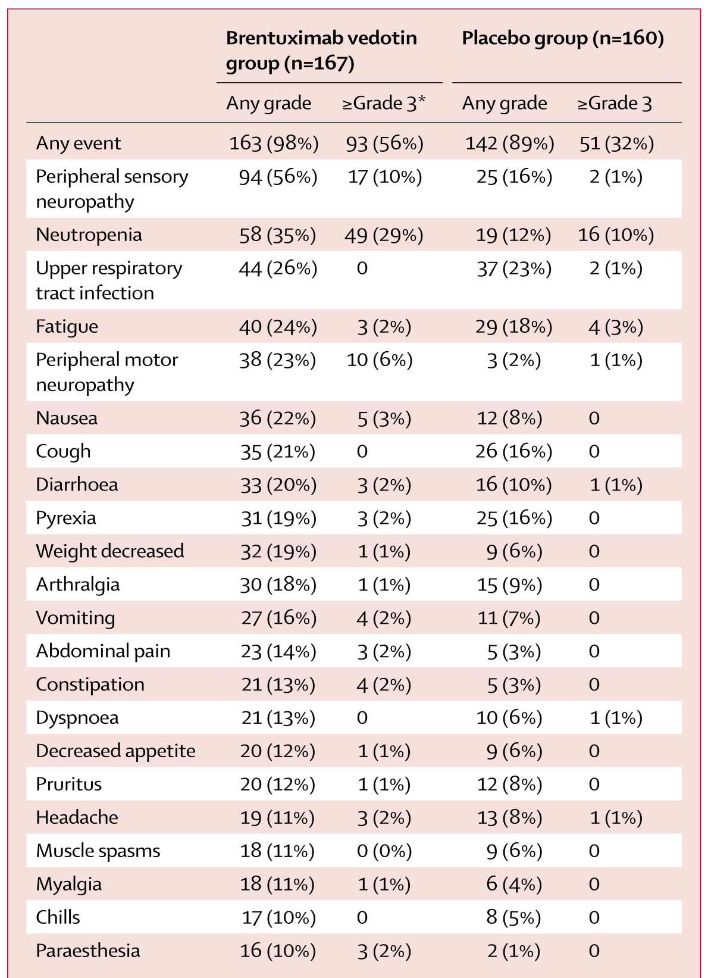
Administration of brentuximab vedotin or placebo was done over 30 min on day 1 of each 21 day cycle once every 3 weeks for up to 16 cycles.

Slide 16
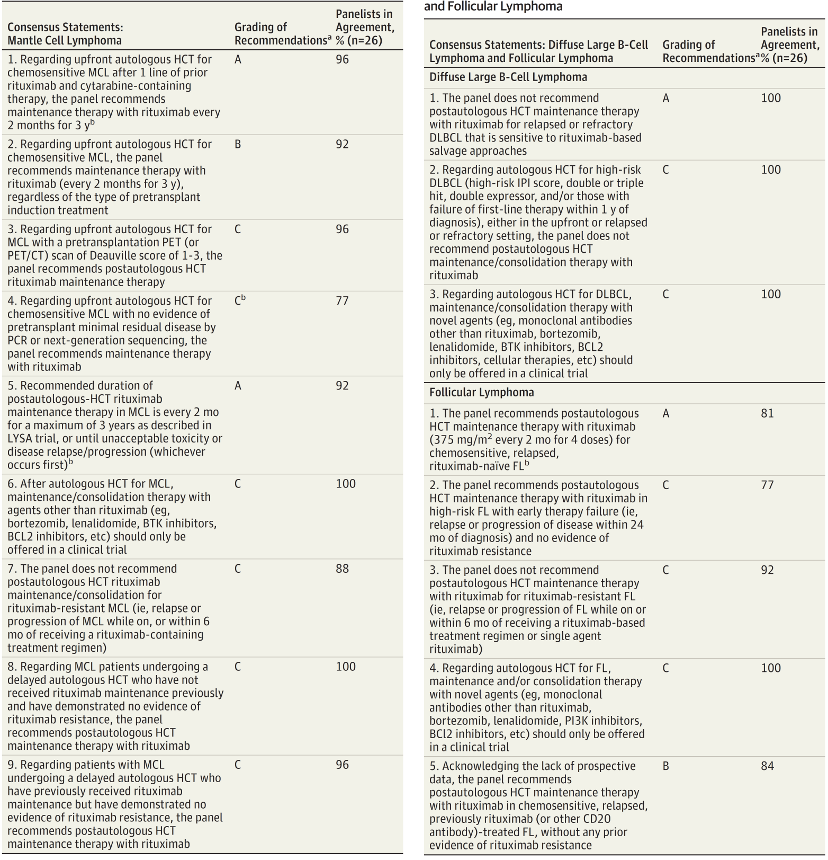

Slide 17
Thank you for your time…

